Slide 1
KIDS
SAFETY
ZONE
KNOW THE RULES: BE SAFE AROUND ELECTRICITY
Notes:
Welcome! My name is ________________ and I’m here visiting with you on behalf of Victoria Electric Cooperative, Inc. We are here to educate you on electrical safety. Are yall ready to become official electrical safety trainees

Slide 2
Electricity is created by the movement of tiny particles called electrons.
We can’t see, smell or taste them but when in motion, they generate a current of energy.
This current powers things we use every day…
What is electricity?

Slide 3
Electricity moves through conductors.
Objects that are conductors of electricity are made of material that let’s electrons move quickly.
Water
Metals
Trees
People
How does electricity move?

Slide 4
Insulators of electricity do not let electrons move as freely:
Glass
Porcelain
Plastic
Cloth
What is an insulator?

Slide 5
Think of electrical current like a current of water.
A trickle of water won’t feel very strong but a crashing wave can knock you off your feet.
Just like:
A tiny electrical current may give you a static charge.
A stronger electrical current can hurt or kill you.
Can electricity hurt you?

Slide 6
Electrical wires, cables or lines carry enough electricity to power the homes in an entire neighborhood. Usually they are safe, but sometimes things can damage them.
Storms
Car Accidents
Tree Limbs
Are electrical wires dangerous too?

Slide 7
Heavy Protection
Special Tools
Lots of Safety Training
How can people work on power lines and stay safe?

Slide 8
How can I
Play safe
and stay
safe?

Slide 9
PLAY SAFE
outside
Never DIG
around
power lines
Never PLAY
around power
lines
Never THROW
things around
power lines
Never CLIMB
trees around
power lines!

Slide 10
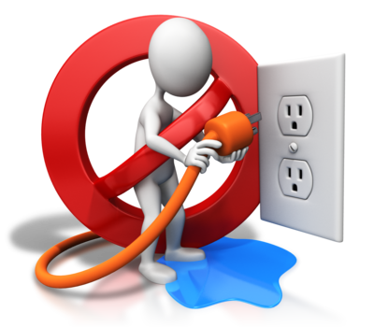
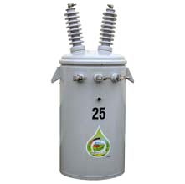
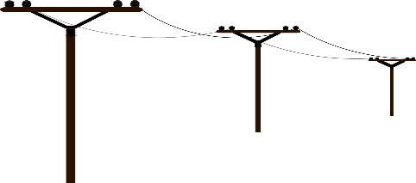
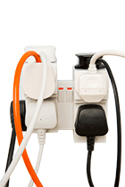
STAY SAFE
NEVER
Put metal objects in outlets or appliances.
inside
NEVER
Mix water and electricity.
STAY AWAY
From transformers and substations.
STAY AWAY
From power lines.
DON’T
Plug too much stuff into one outlet.

Slide 11
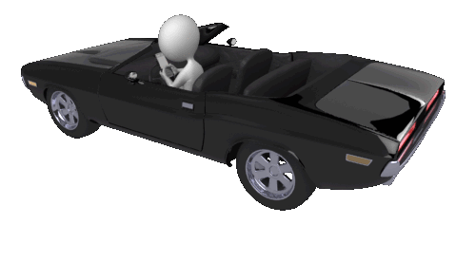
STAY SAFE
On the road
If you’re in a car near a downed power line, NEVER get out of the car.

Slide 12
My Electrical
Safety Pledge
To earn my Electrical Safety hard hat, I pledge to play safe and stay safe
S
A
Pledged by Electrical Safety Trainee:
afety is EVERYONE’S responsibility.
lways ask a grown up for help
when using something that
requires electricity.
F
E
allen power lines are dangerous, never touch or get near them.
Signature
lectricity and water do not mix, keep electrical items away from water.

